Slide 1
Macroeconomics ECON 101
Economics: Foundations and Models
(Chapter 1)
Instructor: Muhebullah Karimzada
Notes:
If this PowerPoint presentation contains mathematical equations, you may need to check that your computer has the following installed:
1) MathType Plugin
2) Math Player (free versions available)
3) NVDA Reader (free versions available)

Slide 2
Chapter Outline
1.1 Three Key Economic Ideas
1.2 The Economic Problems All Societies Must Solve
1.3 Economic Models
1.4 Microeconomics and Macroeconomics
1.5 The Language of Economics

Slide 3
What Is Economics? (1 of 2)
People make choices as they try to attain their goals. Choices are necessary because we live in a world of scarcity.
Scarcity: A situation in which unlimited wants exceed the limited resources available to fulfill those wants.
Economics is the study of the choices people make to attain their goals, given their scarce resources.
Economists study these choices using economic models, simplified versions of reality used to analyze real-world economic situations.

Slide 4
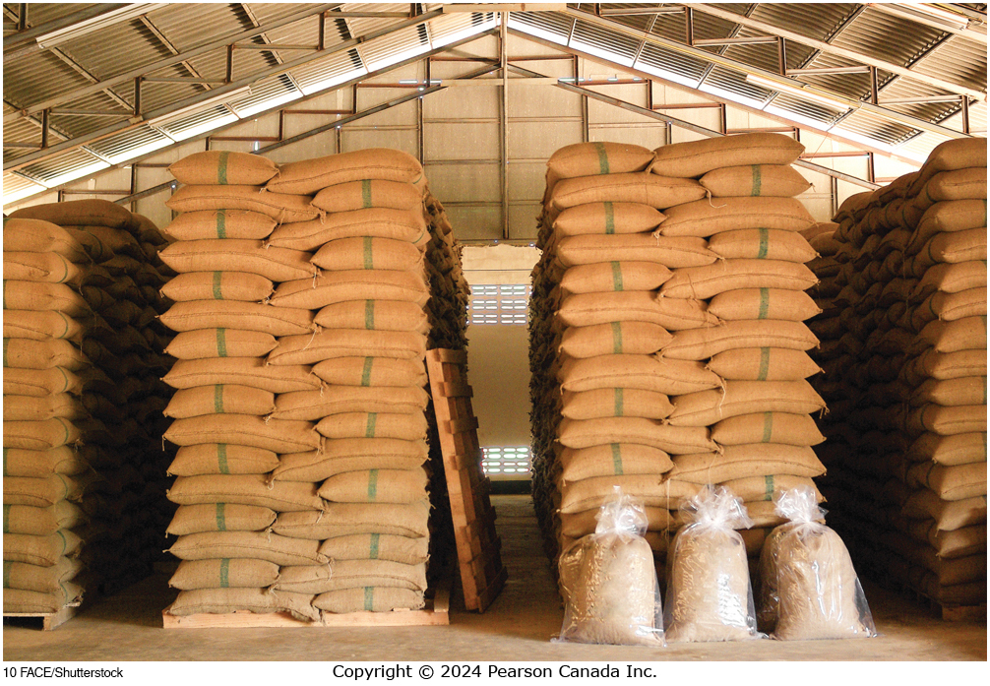
What Is Economics? (2 of 2)

Slide 5
Typical “Economics” Questions
We will learn how to answer questions like these:
How are the prices of goods and services determined?
How do government spending and taxation affect the economy?
Why do governments control the prices of some goods?
Why are some countries wealthier than others?

Slide 6
Three Key Economic Ideas
1.1 Learning Objective
Explain these three key economic ideas:
People are rational.
People respond to incentives.
Optimal decisions are made at the margin.

Slide 7
1. People are Rational
Economists generally assume that people are rational.
Rational: People make choices based on what they believe will make them happy. People do not deliberately do things to make themselves worse off.
Rational decision makers weigh costs and benefits.
Example: You won’t buy a $5 cup of coffee unless you believe it will be worth at least the time and effort it takes you to earn $5.

Slide 8
2. People Respond to Incentives
As costs and benefits change, so do the actions that people will take.
Example: Do Canadian banks choose to get robbed?
“Bullet-resistant shields” cost $20,000
Typical loss due to an armed robbery is $1,200
Armed robbery is rare
Result – no bullet-resistant shields

Slide 9
3. Optimal Decisions Are Made at the Margin
Most decisions involve doing a little more or a little less of something.
Example: Should you watch an extra hour of T V, or study instead?
Marginal cost and benefit (M C and M B): the additional cost or benefit associated with a small amount extra of some action.
Comparing M C and M B is known as Marginal Analysis.

Slide 10
The Economic Problems All Societies Must Solve
1.2 Learning Objective
Discuss how an economy answers these questions:
What goods and services will be produced?
How will the goods and services be produced?
Who will receive the goods and services produced?

Slide 11
1. What Goods and Services Will Be Produced?
All societies must decide which goods and services to produce.
Producing more of one thing means producing less of another.
This is a trade-off, resulting from the scarcity of productive resources.
Opportunity cost: the value of the best alternative.
Example: the opportunity cost of increased funding for health care might be fewer university scholarships.

Slide 12
2. How will the Goods Be Produced?
A firm might have several different methods for producing its goods and services.
Example #1: A music producer can make a song sound good by:
Hiring a great singer and using standard production techniques.
Hiring a mediocre singer and using Auto-Tune to correct the inaccuracies.
Example #2: As the cost of manufacturing labour changes, a firm might respond by:
Changing its production technique to one that employs more machines and fewer workers.
Moving its factory to a location with cheaper labour.

Slide 13
3. Who Will Receive the Goods and Services?
Who gets the things we make?
This depends largely on income distribution.
People with highest incomes have the ability to buy the most goods and services.
Governments can change the income distribution through taxation and transfers (redistribution).

Slide 14
Centrally Planned Economies vs. Market Economies
Centrally planned economy: An economy in which the government decides how economic resources will be allocated.
Market economy: An economy in which the decisions of households and firms interacting in markets allocate economic resources.
Mixed economy: An economy in which most economic decisions result from the interaction of buyers and sellers in markets but in which the government plays a significant role in the allocation of resources.
Which of these best describes Canada today?
Canada is a mixed economy.
Hospitals are centrally planned by provincial governments
Fast food is organized by markets

Slide 15
Efficiency and Equity
Market economies tend to be more efficient than centrally-planned economies.
Market economies promote:
Productive efficiency, a situation in which a good or service is produced at the lowest possible cost; and
Allocative efficiency, a state of the economy in which production is in accordance with consumer preferences; in particular, every good or service is produced up to the point where the last unit provides a marginal benefit to society equal to the marginal cost of producing it.

Slide 16
Source of Efficiency and Equity
Productive efficiency comes about because of competition.
Allocative efficiency arises due to voluntary exchange.
Voluntary exchange: A situation that occurs in markets when both the buyer and the seller of a product are made better off by the transaction.
Each transaction that takes place improves the well-being of the buyer and seller; transactions continue until no further improvement can take place.

Slide 17
Efficiency and Equity (continued)
Markets may not result in fully efficient outcomes. For example:
It takes time to figure out the most efficient production method
Governments might interfere with market outcomes
Market outcomes might ignore people who are not involved in transactions – ex: Externalities
Economic efficiency is not the only possible objective.
Equity matters too.
Equity refers to as the fair distribution of economic benefits.

Slide 18
Economic Models
Economists develop economic models to analyze real-world issues.
Building an economic model often follows these steps:
Decide on the assumptions to use in developing the model.
Formulate a testable hypothesis.
Use economic data to test the hypothesis.
Revise the model if it fails to explain the economic data well.
Retain the revised model to help answer similar economic questions in the future.

Slide 19
Important Features of Economic Models
Role of Assumptions: every model needs them in order to be useful.
Hypothesis Testing: good models generate testable predictions, which can be verified or disproven using data.
Economic variables: something measurable that can have different values, such as the incomes of doctors.

Slide 20
The Scientific Nature of Economics
Economists try to mimic natural scientists by using the scientific method.
Economics remains a social science and people often have ideas about what the results “should” be.
Two types of analysis:
Positive analysis: analysis relying on facts or logic.
Normative analysis: analysis relying on value judgments.
Words like “should” or “ought” are often used.
Economics tries to stick to positive analysis.

Slide 21
Apply the Concept: Should the Government Cap the Price of Houses? (1 of 2)
There are trade-offs to a cap on house prices
The Benefit:
Limiting the price of houses helps many people buy a house at a lower price
Reducing housing costs frees up money for Homeowners to spend on other things.
The Cost:
A cap on house prices reduces the number of new houses built.
When fewer houses are built, fewer people are employed in the trades.
The size of each effect is positive.
The importance of each effect is normative.

Slide 22

Apply the Concept: Should the Government Cap the Price of Houses? (2 of 2)

Slide 23
Microeconomics and Macroeconomics
1.4 Learning Objective
Distinguish between microeconomics and macroeconomics.
Microeconomics is the study of
how households and firms make choices,
how they interact in markets, and
how the government attempts to influence their choices
Macroeconomics is the study of the economy as a whole, including topics such as inflation, unemployment, and economic growth.

Slide 24
The Language of Economics (1 of 2)
1.5 Learning Objective
Define important economic terms.
Economics has its own terms and jargon with specific, precise meanings.
Sometimes these terms will be used in ways that differ even from closely related disciplines.

Slide 25
The Language of Economics (2 of 2)
Examples:
Technology: the processes a firm uses for turning inputs into outputs of goods and services
Capital: durable manufactured goods that are used to produce other goods and services
Pay close attention to terms defined in class and in the textbook!

